Slide 1
Korama Tree Planting Initiative Lessons from Experience
Prof. Ahmadu Sanda
Presented to:
Coalition of Biodiversity Conservationists of Nigeria, 19th October, 2020

Slide 2
Sketch of presentation
1. Introduction
2. Korama Tree Planting Initiative: history, achievements and lessons
3. Kebbi Development Forum, KDF (2016 and 2020)
4. Zuru Patriotic Forum, ZPF (2019 and 2020)
5.Tree Planting Campaign at Usmanu Danfodiyo University, Sokoto
6. Conclusion

Slide 3
Introduction
Human activities have caused rapid depletion of our natural resources. As a consequence, a rapid increase in the pace of deforestation has been witnessed in this part of the world and this has led to the disappearance of many plant and animal species.
The need to contribute to the restoration of biodiversity through continuous planting of trees has been the chief motivation for starting the Korma Tree Planting Initiative, and maintaining the tempo of progress.

Slide 4
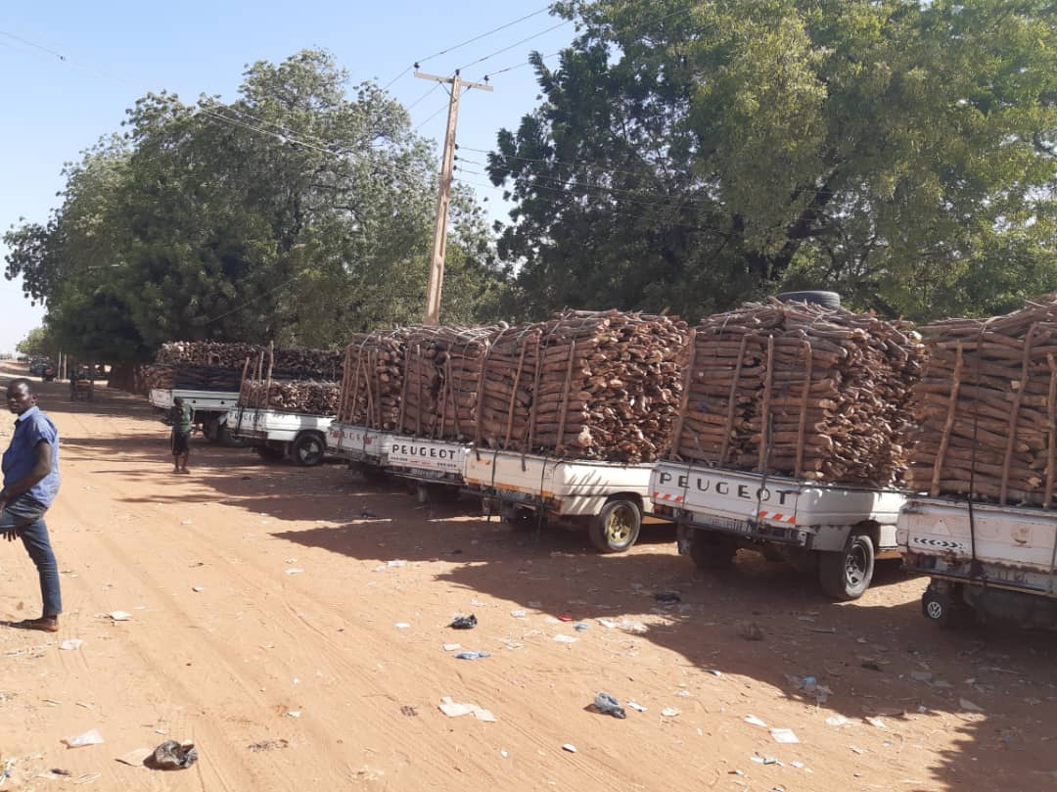
Massive deforestation!

Slide 5
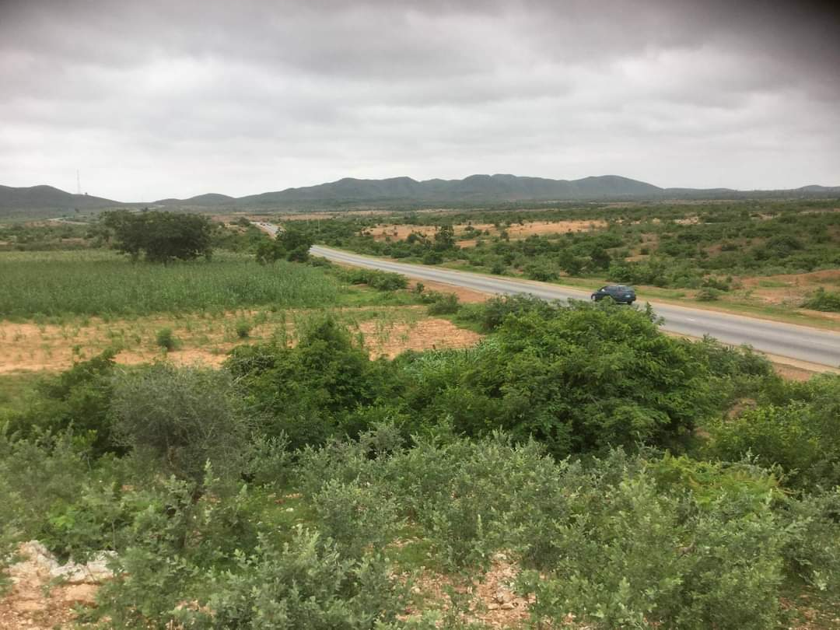
Introduction - continued Trees are shorter and increasingly sparely populated

Slide 6
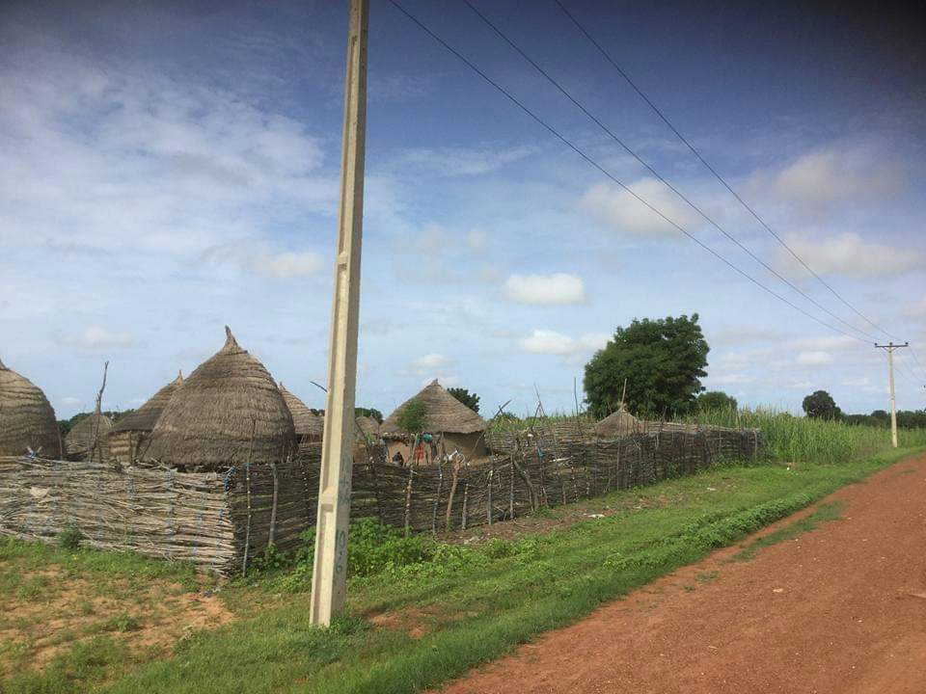
Even remote areas are not spared

Slide 7
Korama Tree Planting Intervention Geographical location
Korama community is located in Fakai Local Government in Kebbi State of Nigeria.
Kebbi State shares a boarder with Niger Republic, exposing the state to the advance of the Sahara.
We observed a steady decline in plant in animal species in Korama, a factor that motivated us to start the project in 2009.

Slide 8
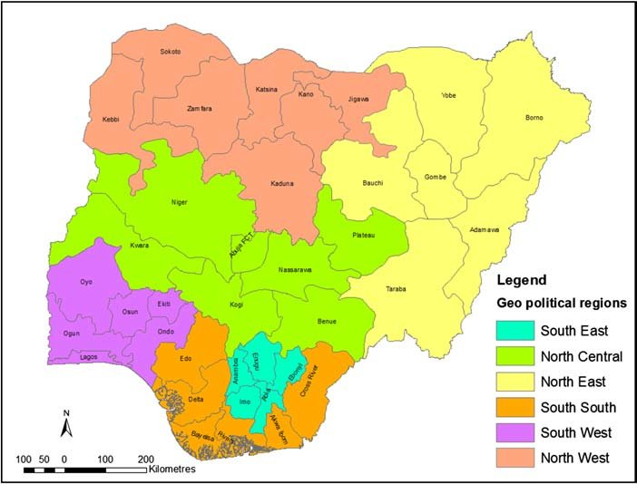
Map of Nigeria

Slide 9
Korama project - continued
The Korama project has been funded mainly by its sponsor, Prof. Ahmadu Sanda, a lecturer of economics at Usmanu Danfodiyo University, Sokoto.
The project started in 2009 with about 500 trees.
Because the initial location was very close to the community, children and stray animals limited the tree survival rate in that year.
We therefore relocated to a safer location not easily accessible to children, but close enough for adults in the community to see and learn from.

Slide 10
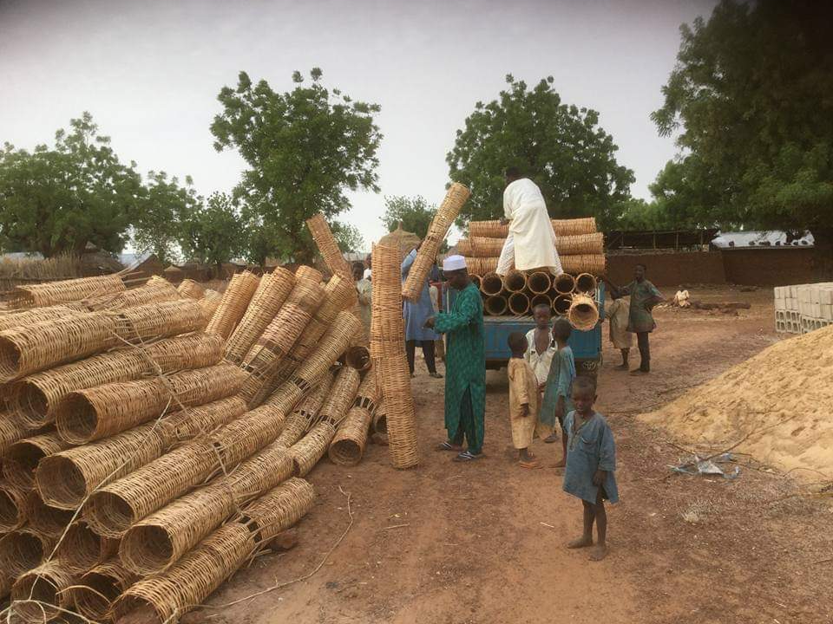
Purchase and transportation of baskets

Slide 11
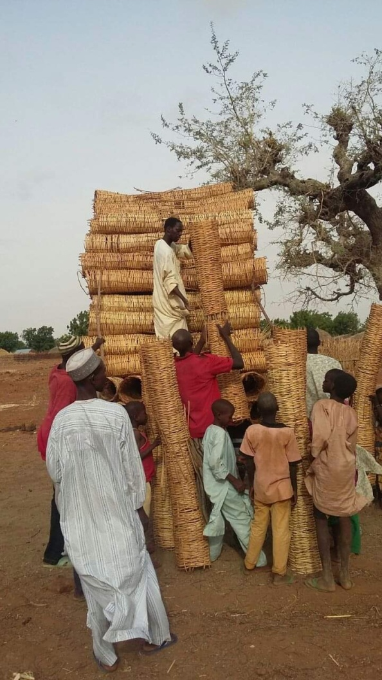
Purchase and transportation of baskets

Slide 12
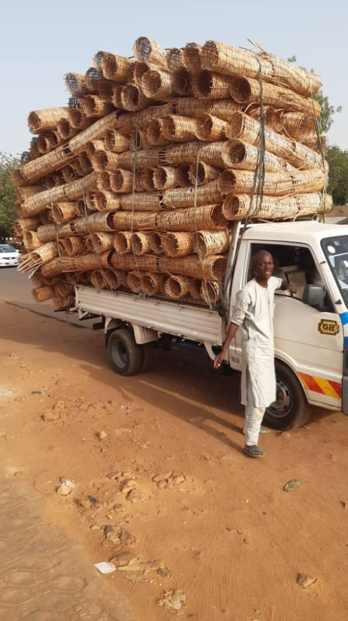
Purchase and transportation of baskets

Slide 13
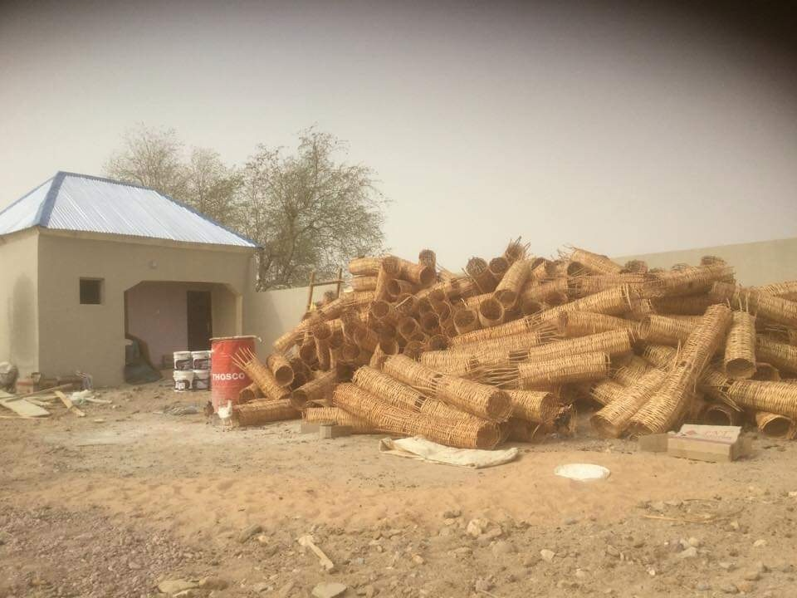
Baskets arrive on project site

Slide 14
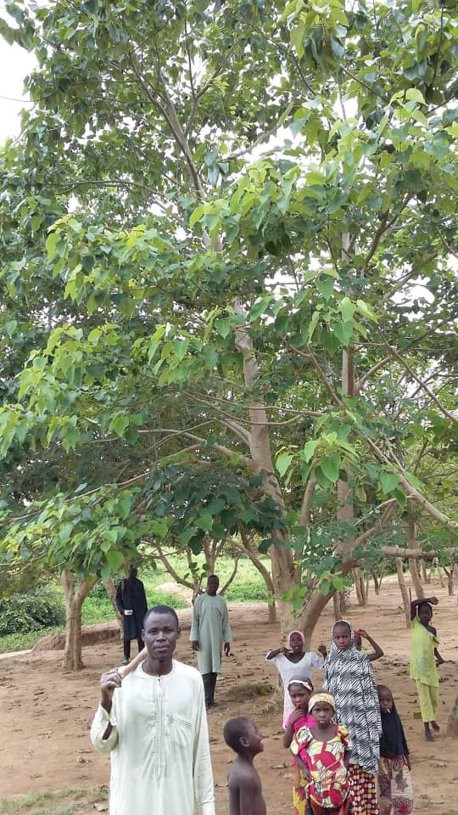
Trees are growing and increasing in number

Slide 15
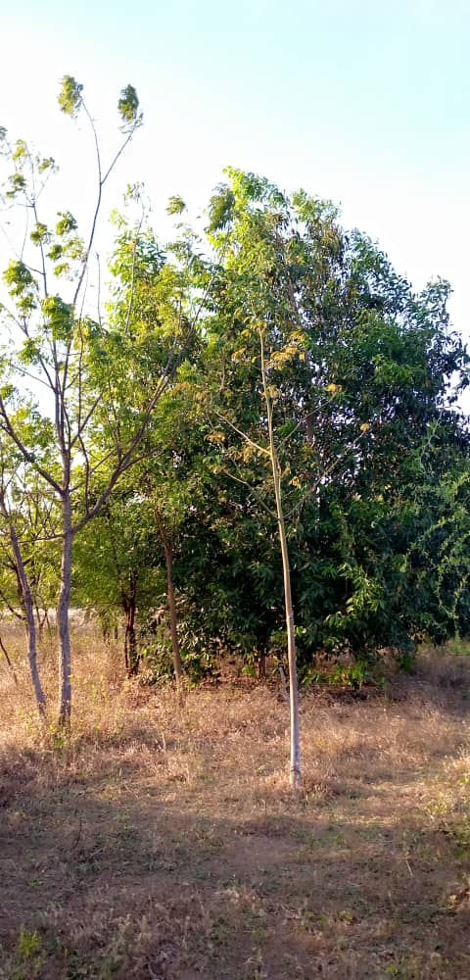

Slide 16
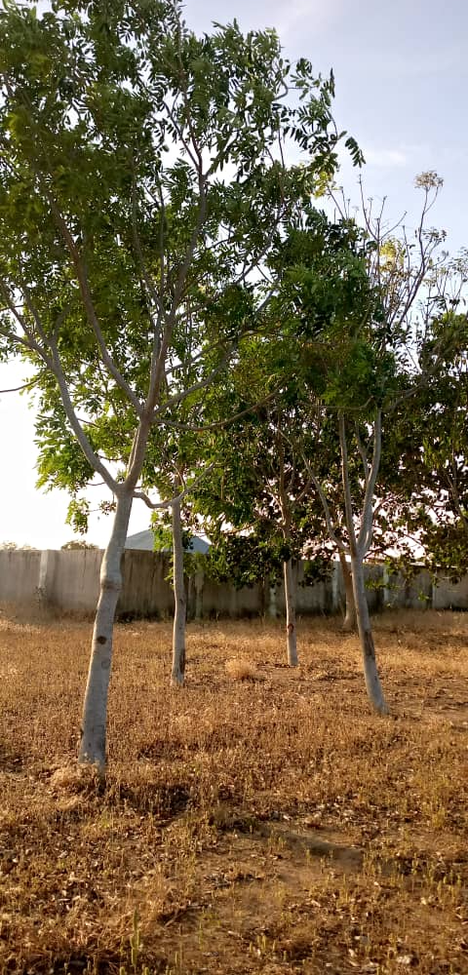
Trees are growing in number and size

Slide 17
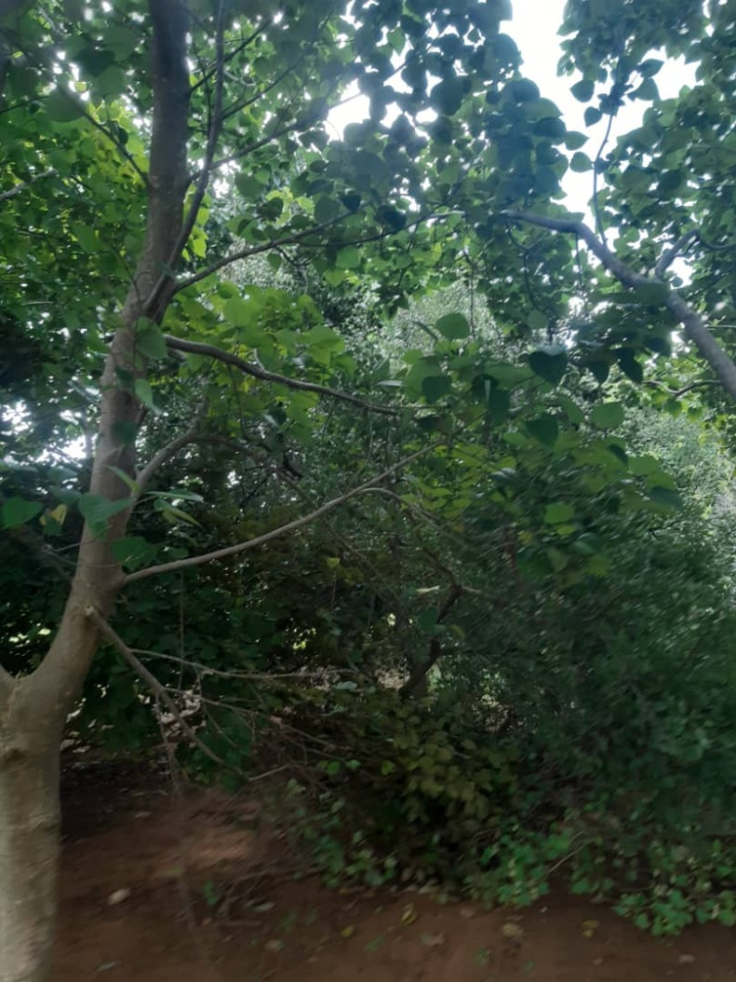
Trees are growing in number and size

Slide 18
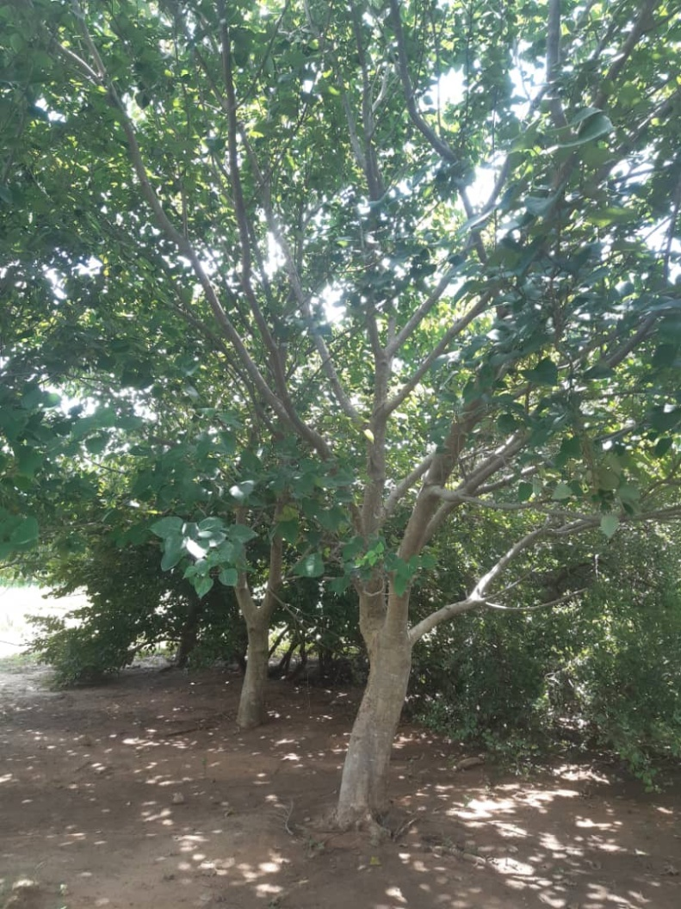
Trees are growing in number and size

Slide 19
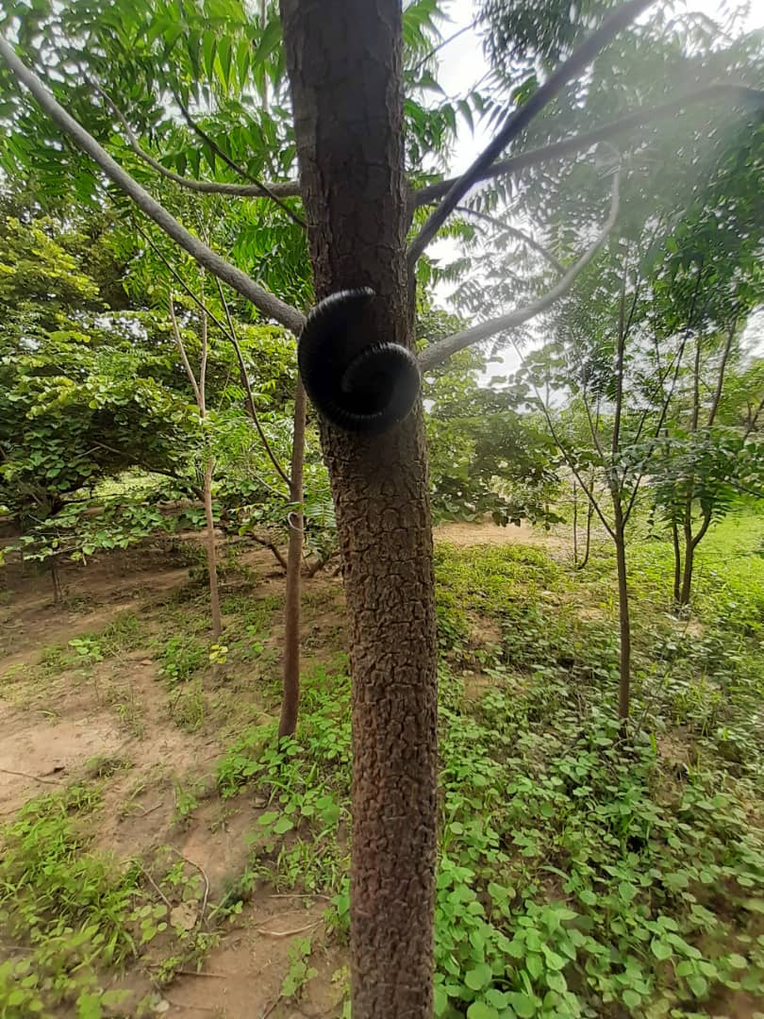
Trees are providing home for animals and birds

Slide 20
KDF 2016 Tree Planting Project
In 2015/2016, I chaired the KDF tree planting campaign. Members on its WhatsApp platform donated generously into a pool, enabling us to plant 150 in one community in each of the 21 LGAs.

Slide 21
KDF 2016 Tree Planting Project - continued
Tree survival rate in 2016 was very low due largely to the failure of most of the communities to fulfill their promise to water the plants in the long dry season.
However, a few communities such as Kwakware in Suru LGA and Mungadi in Maiyama LGA did well, each recording about 40% survival rate.

Slide 22
KDF 2020 Tree Planting Project
I was appointed for the second time Chair of the KDF’s tree planting campaign for 2020.
WhatsApp members numbering over 250 made generous contributions towards the project. We raised almost 1.5million naira through donation for the project.
Out of the many boarding schools in the state, we selected four that best met our selection criteria, which were:
Fence
Water
Boarding School
Expressing of interest by the school principal

Slide 23
KDF 2020 Tree Planting Project - Continued
The second tree planting project of KDF started in July, 2020. In order to improve tree survival rate, we planted 250 trees in each of the four boarding schools for this year’s intervention:
Dr Amina Govt Girls College, Birnin Kebbi (girls)
Zango Sule Government Secondary School, Kangiwa (boys)
Sarki Abdullahi College Birnin Yauri (mixed)
Mama Arziki Comprehensive High School, Senchi (mixed)

Slide 24
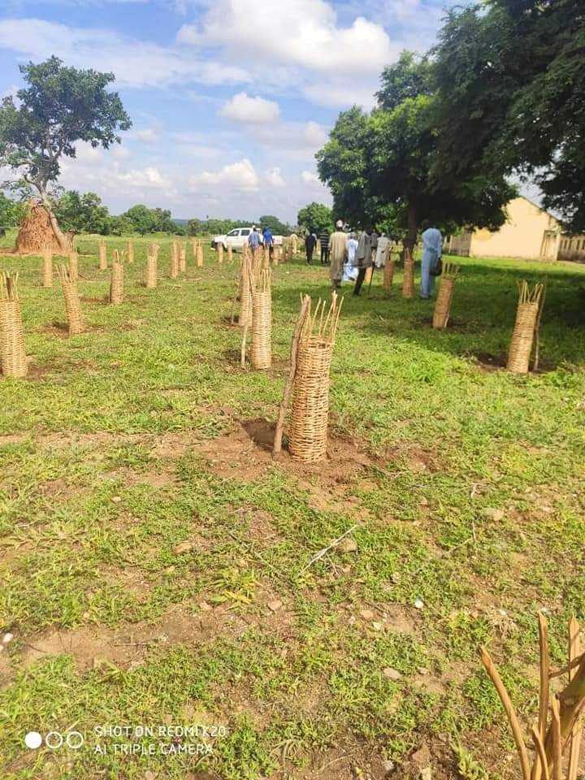
KDF 2020 Tree Planting Project - Continued

Slide 25
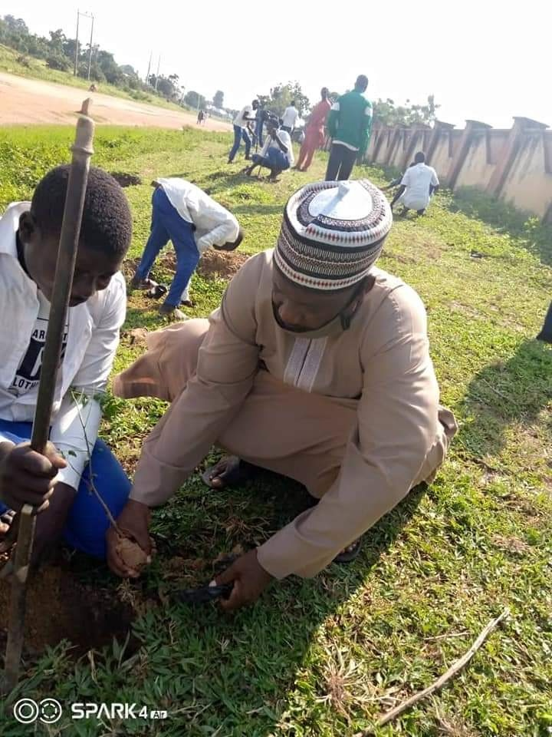
KDF 2020 Tree Planting Project - Continued

Slide 26
ZPF 2019 Tree Planting Project
In 2018, the Zuru Patriotic Forum was established. I became a member of ZPF in the same year.
I was charged with responsibility to support its tree planting campaign
In 2019, an anonymous donor provided funding to ZPF to plant 400 trees at Federal Technical College, Zuru

Slide 27
ZPF 2019 Tree Planting Project - continued
Tree survival rates in this project were over 95% due in part to effective supervision of workers hired in the dry season to water the plants.
Encouraged by this impressive survival rate, ZPT in 2020 got two anonymous persons to sponsor its 2020 tree planting campaign.

Slide 28
ZPF 2020 Tree Planting Project - Continued
The generous funding allowed ZPF to plant 200 trees each in the following girls’ schools:
A) Government Girls Science College, Ribah
B) Government Girls Science College, Maga

Slide 29
ZPF 2020 Tree Planting Project - Continued
Other ZPF’s tree planting interventions
ZPF has also supported tree planting campaigns in Matseri and Dabai. The Matseri project includes an erosion control project led by a member of this coalition.

Slide 30
Tree planting campaign in Usmanu Danfodiyo University, Sokoto
We have supported the University in its efforts to green the environment.
In 2010, the Vice Chancellor gave us funding to plant 400 trees near the Faculty of Education. The trees have grown fast, forming a canopy in the area.

Slide 31
Tree planting campaign in Usmanu Danfodiyo University, Sokoto - Continued
In 2017, Mr. Ashish Madan and I made a joint contribution to plant about 400 trees in two newly built students hostels on the permanent site of the University.
Mr Ashish Madan wanted to present his tree planting effort to his father, who had lectured in the University in the 1980s, as a birthday surprise.
The next slide shows our picture at the handing over ceremony of the trees to the University authorities.

Slide 32
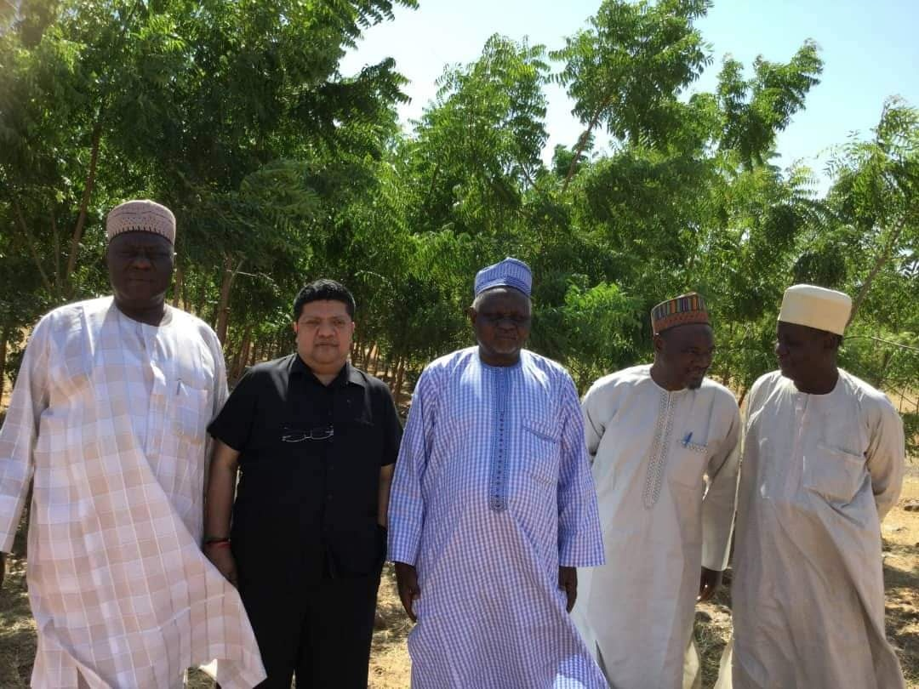
Tree planting campaign in Usmanu Danfodiyo University, Sokoto -Continued

Slide 33
Conclusion
Trees have many benefits, not least their ability to provide food, shelter, housing materials and cooking fuel. In addition, they provide home for wild animals, birds and insects, helping to enrich the soil and the natural habitat in general. They are critical in increasing the supply of oxygen and reducing carbon dioxide, helping to reduce global warming.
Trees can provide fodder in the dry season, helping to reduce herder-farmer clashes.

Slide 34
Conclusion - Continued
We are racing against time in this effort to reverse deforestation and loss of biodiversity. As individuals, firms, NGOs and governments, we all need to play our part in this endeavor that aims to plant trees and restore the natural habitat.

Slide 35
Conclusion - continued
Despite the time and resources it may consume, planting trees is never a burden for those that are passionate about it;
Instead, from our modest project that began in 2009, one could state that tree planting provides satisfaction and great fun.

Slide 36
A short video clip from Korama

Slide 37
Thank you all and God bless

